Slide 1



Executive Summary
User Persona
Consumer Journey
Industry Insights
Recommendations
Financial Projection
Implementation Plan
Based on 280+ credit card users, 3 typical consumer profiles are defined and high income professionals have been identified as the key growth segment
Focus Group
Importance of Features
High Income
Professional
Mid Spend
Entrepreneurs
Value Oriented Professionals
Rewards
Income: > Rs2 lakh
Spend: 1 lakh – 2 lakh
Mostly spends on Travel and Online Shopping
Income: Rs 1 lakh – 2 lakh
Spend: Rs 1 lakh – 2lakh
Mostly spends on Travel, dining and food delivery
Income: Rs 1 lakh – 2 lakh
Spend: Rs 50,000 -1 lakh
Mostly spends on online shopping and EMI purchases
Fees
Characteristics
Brand Trust
Lounge Access
Pain Points
No control over rewards and transaction being declined without clear reason
Difficult reward redemption process
Slow Onboarding and high interest charges on late payments
International Usage
EMI Option
Fuel Waiver
Cobranded Benefits
International Usage
Lounge Access
Fuel Waiver
EMI Options
Customer Service
Lounge Access
Low Fees
Customer Service
Key
Features
Co-Branded Benefits
Card with customizable reward with different brands allowing to switch benefits from travel to shopping
Card with offers on restaurants and food providing instant cashback compared to accumulated rewards
Low fees card with potentially less rewards but better customer service and EMI benefits
Credit Limit
Potential
Card
Customer Service
Notes:
User Persona

Slide 2
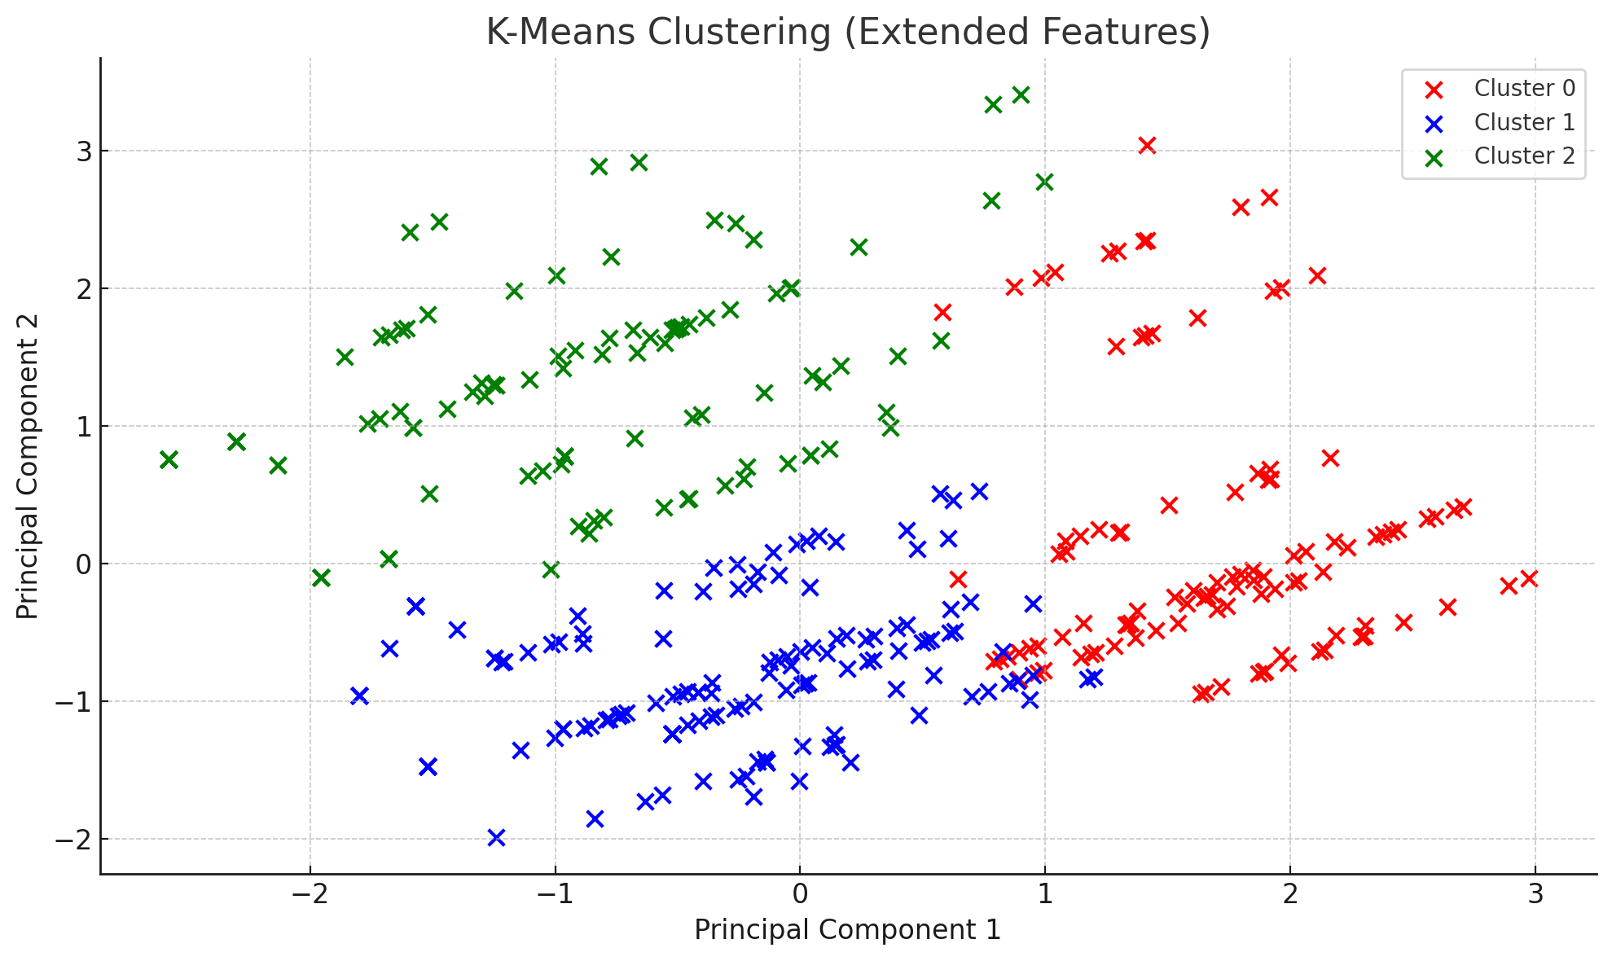
Cluster based on age, occupation, usage, income and spend

Slide 3
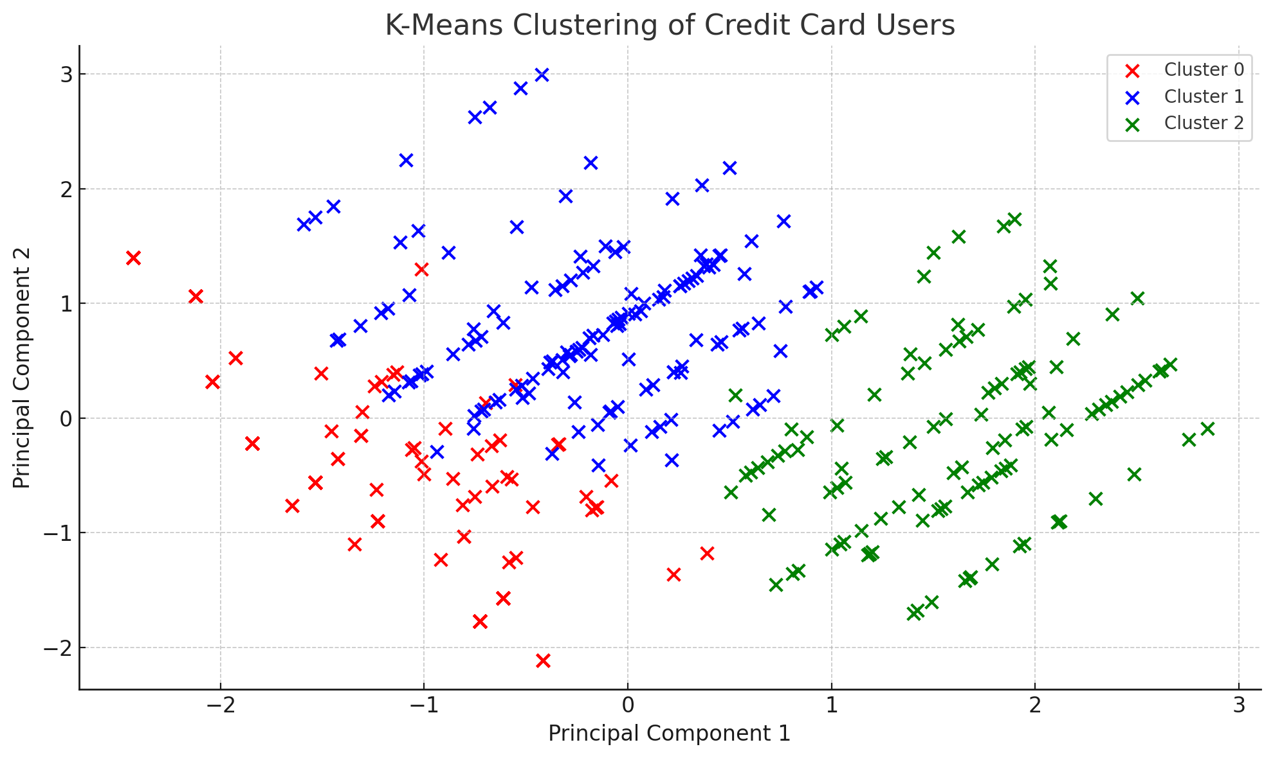
Cluster based on age, usage, income and spend

